Slide 1
2nd February 2023 FORTNIGHTLY NEWSLETTER
19/01/23 FORTNIGHTLY NEWSLETTER
^{22nd} September 2023 Fortnightly Newsletter
Highampton
Community
Primary School
Learn, Care, Grow Together
Wow! What a busy couple of weeks it has been at Highampton! Firstly, you will have noticed that lots has happened around the site.
The estates team have removed the old play equipment and are in the process of fixing the fence at the bottom of the field. Secondly, we are immensely grateful to Mrs Hamilton-Cox and gardening club who have done a wonderful job of clearing the poly tunnel ready for planting.
In school, there has also been a fantastic buzz as we really get stuck into our learning this term. The children are all working as one fantastic team and the whole staff team are feeling very lucky to come to work each day. Celebration assemblies will be resuming next week and we can't wait to share our excitement about our learning with one another and with you.
The weather is changing- Autumn is always lovely in Highampton, if windy! We would like to remind you that your child needs a waterproof coat in school every day, even if it is sunny in the morning. We try to get the children outside as much as we can, whatever the weather.
We are advertising for an Meal Time Assistant. If you know someone who is interested, please direct them to the Trust website (scroll to the bottom).
Finally, we would like to invite everyone to a parent meeting on Wednesday 27th September at 2.30pm where we will discuss our phonics and reading scheme, and expectation for home learning FOBs will be on hand after to offer you a cup of tea and biscuit whilst you meet our senior leadership team.
Many thanks,
Mr Bridge
After School clubs – please book online using school gateway if you would like to join any of the clubs.
​

Slide 2
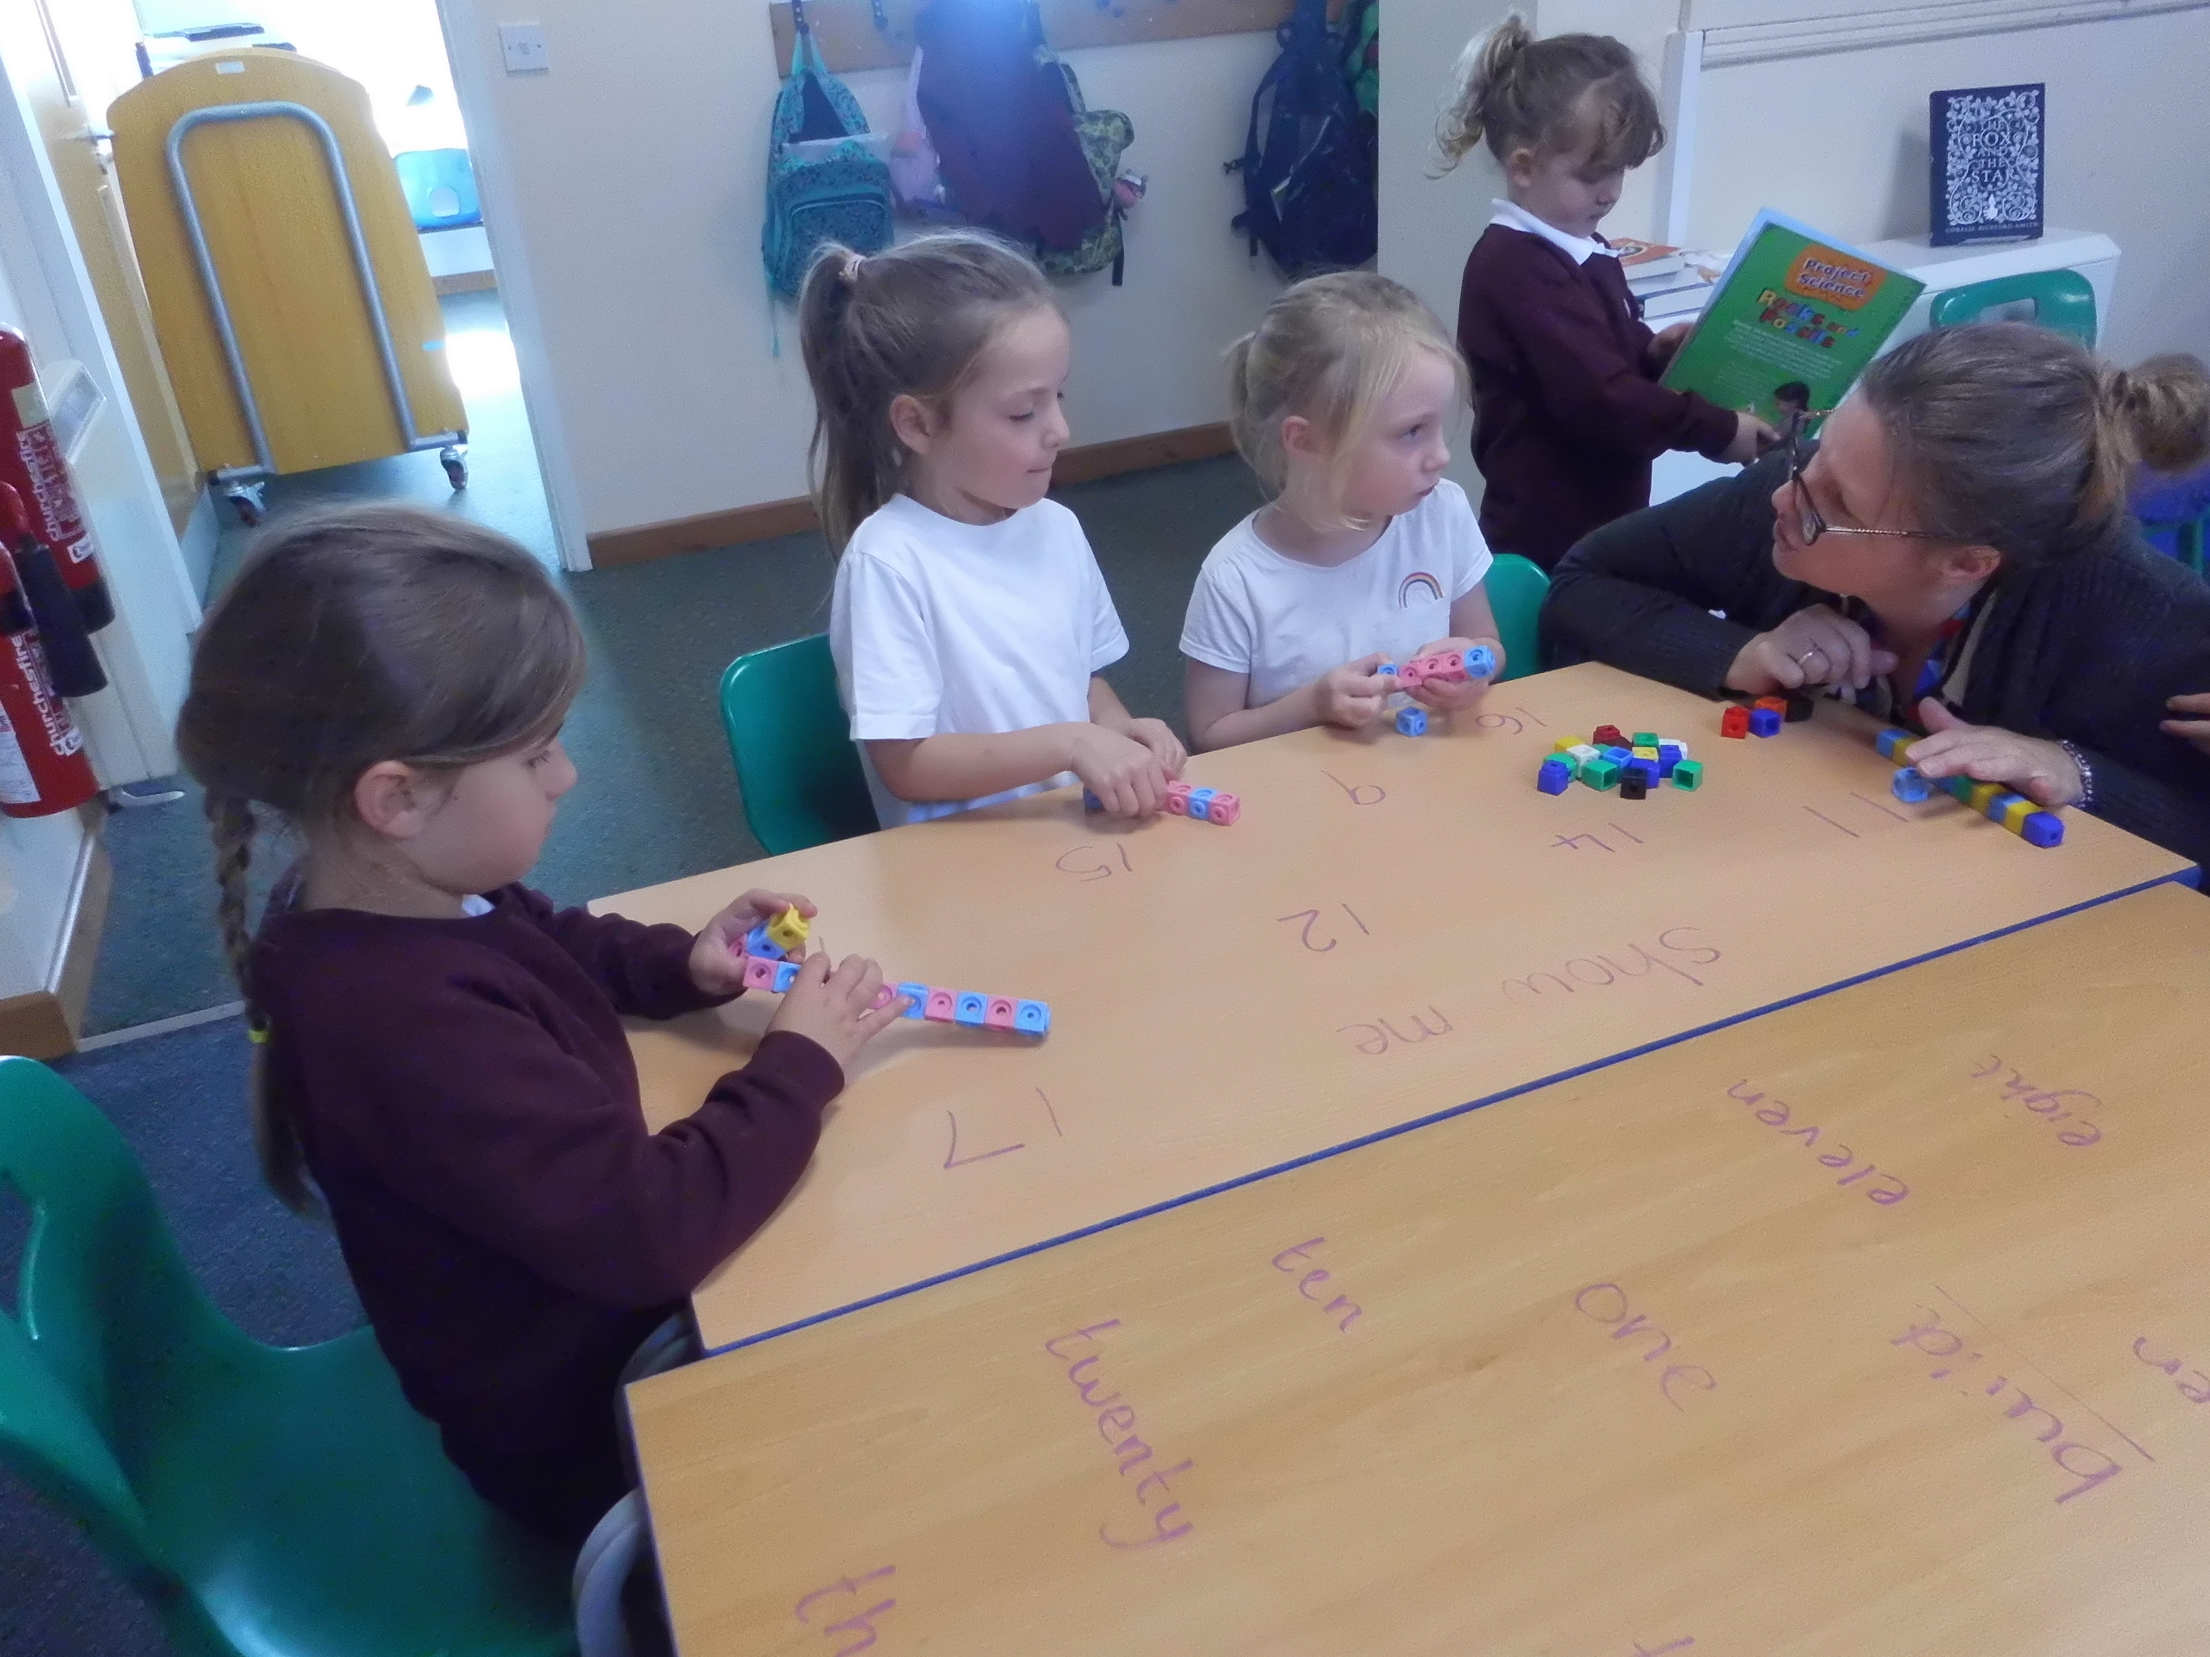
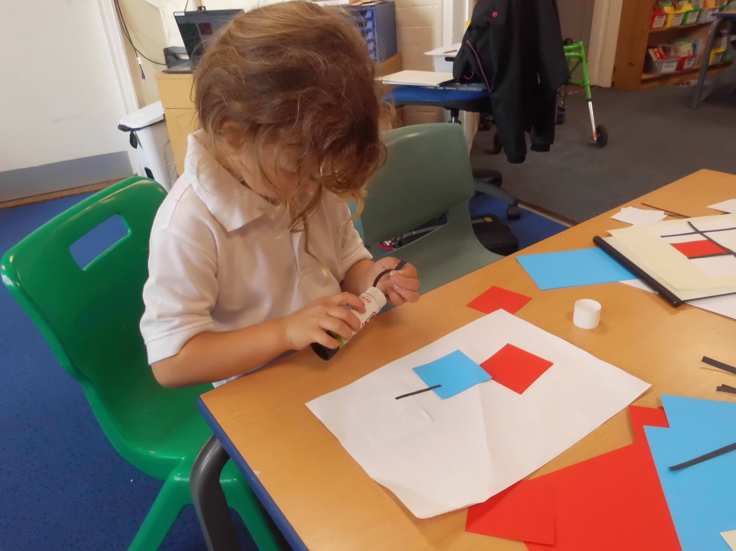
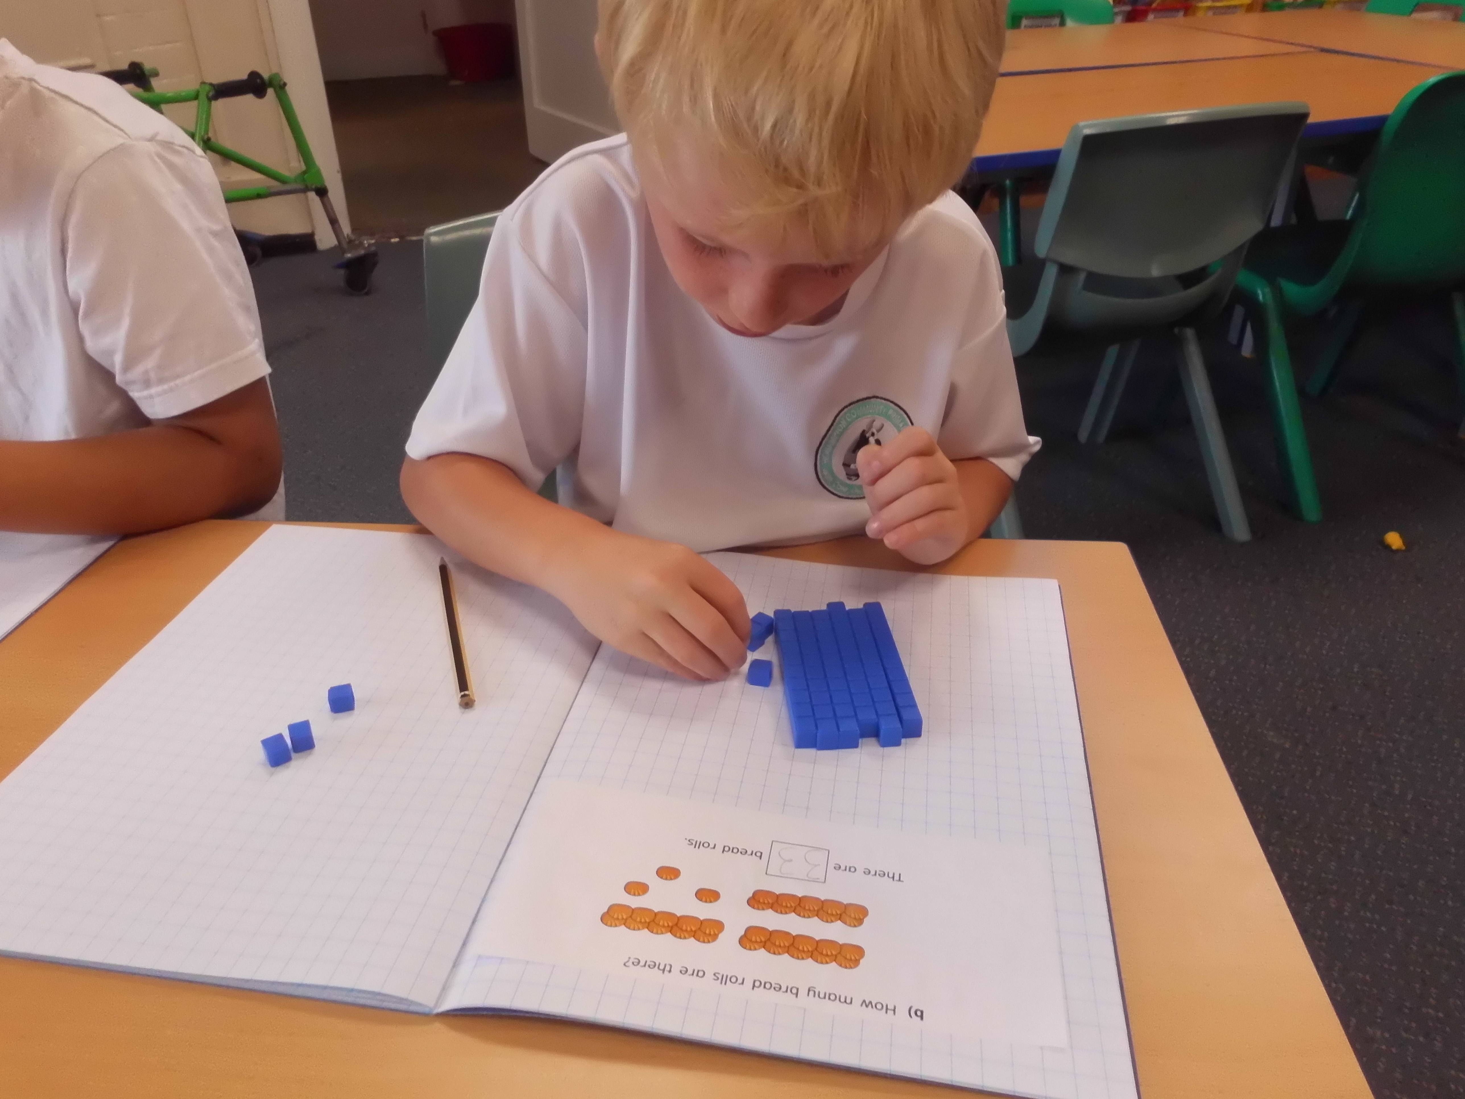
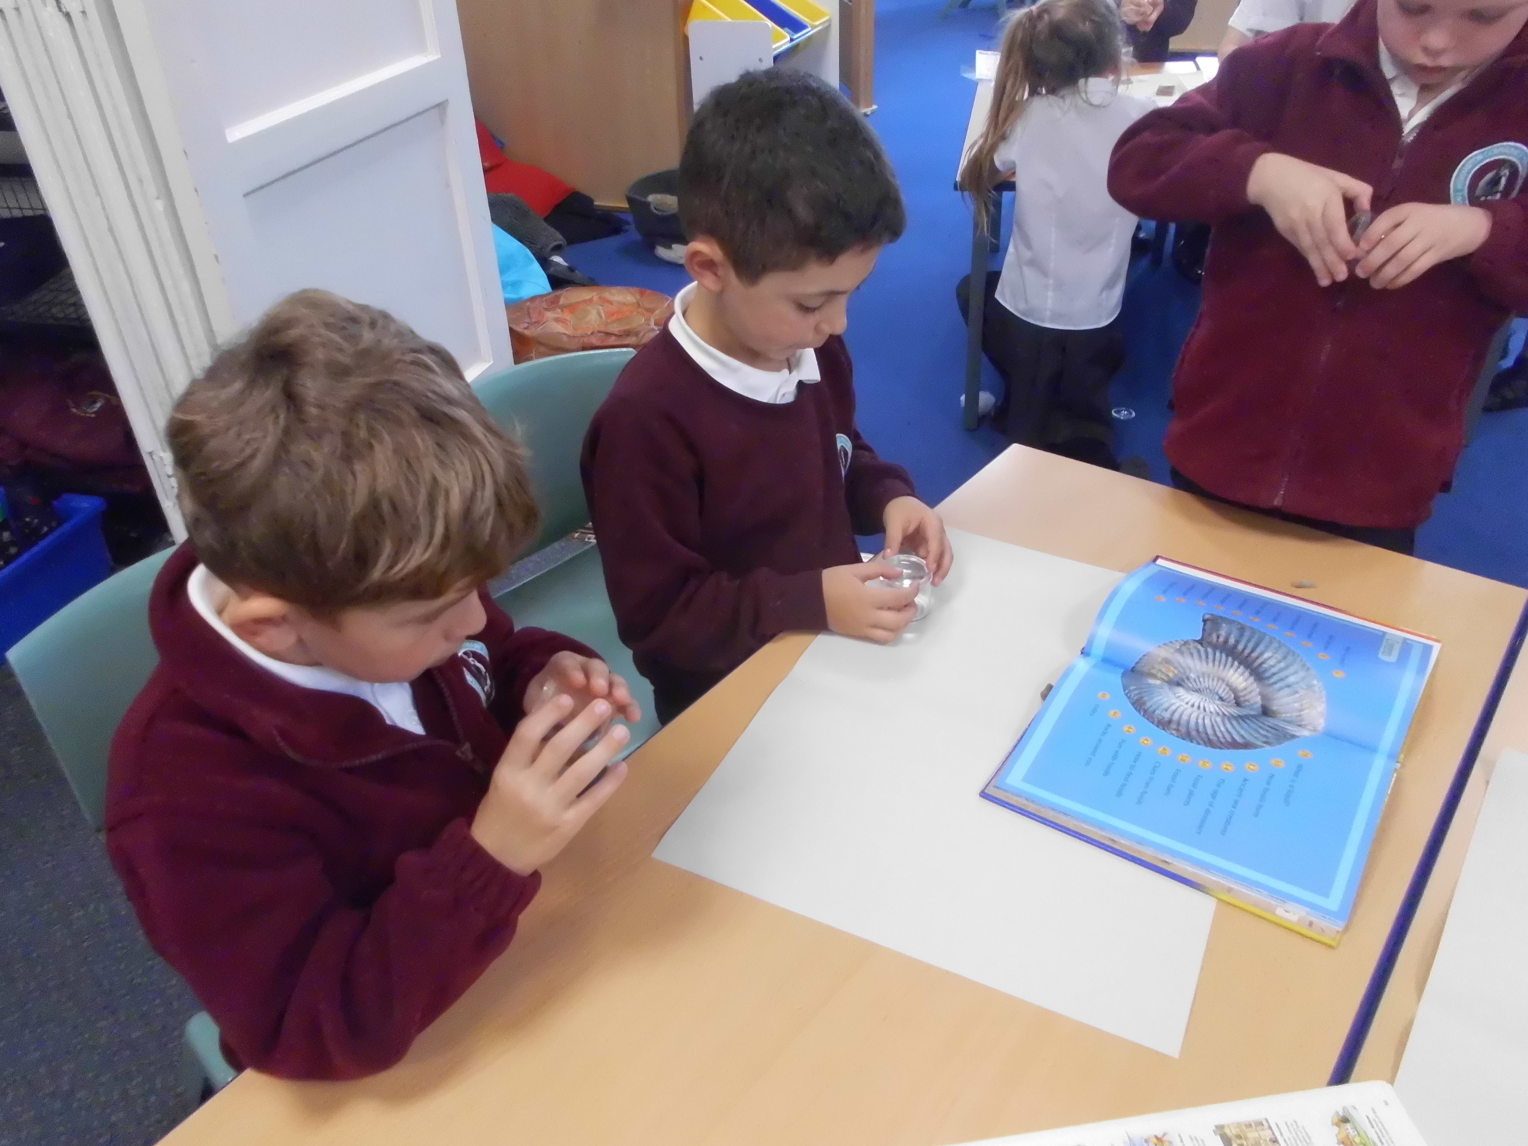
Class News
Notices and Updates
Class News
Tarka Class
We have had an exciting week of learning in Tarka. We have been historians learning about Mary Anning and had a great afternoon identifying fossils. We have been artists, learning about and producing abstract art in the style of Piet Mondrian. The pictures were amazing. We have also loved reading our whole school text The Fox and the Star. What a week!
Ruby Class
This week Ruby Class have had a great week with Mr Bridge and Mrs Luxford. We have been doing some amazing writing retelling the story of the Fox and the Star. Mrs Luxford really enjoyed teaching art and science too. We have also been learning about the Anglo Saxons in History and how animations work in computing.
Dates for your diary
School meeting – 27th September 2023 – 2.30pm
Harvest Day Non- Uniform – 20th October
Hub Admin
Just a reminder that Emily Stevenson, our Hub Admin will be at Highampton all day on a Monday so please pop in if you need to give us any paperwork or need help with anything.
PTFA Christmas Cards
Coming home this week are Christmas card templates for the children to complete at home. These templates will be taken and can be made into cards, gift tags and other items! Any purchases made of your child's design will raise money for the PTFA. (Please return your completed designs by Friday the 29th of September).
Don't forget, you can help raise money for our PTFA just by doing your shopping online. Just download the app and get shopping!

